Slide 1
Applied Data Science Capstone

Slide 2
The objective of this data science project is to show best options between 3 districts (San Isidro, Barranco and Miraflores) to start a restaurant/food business.

Slide 3
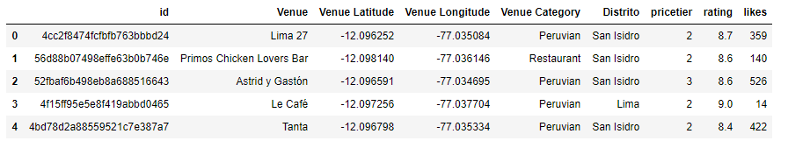
The data used in this project is the following:
100 food venues in 1 km radius for each district (Miraflores, San Isidro and Barranco).
Rating, price tier and quantity of likes for each venue.
All this data was obtained through Foursquare API. An example of the final data is the following:

Slide 4
Librareis Used:
Pandas and numpy were used for data wrangling and analysis
Matplotlib was used for graph display.
Geopy and folium were used for location and displaying data in maps.
Sklearn for algorithms.

Slide 5
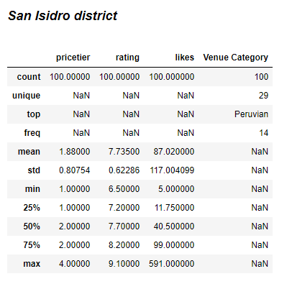
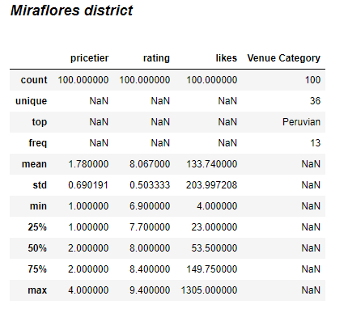
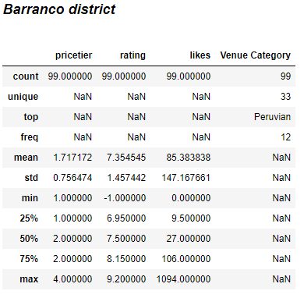
Summary of datasets for each district

Slide 6
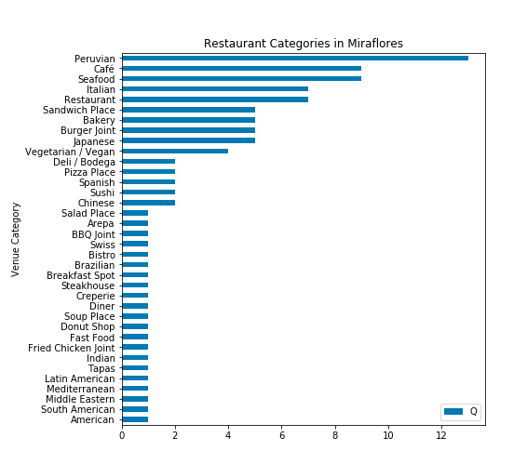
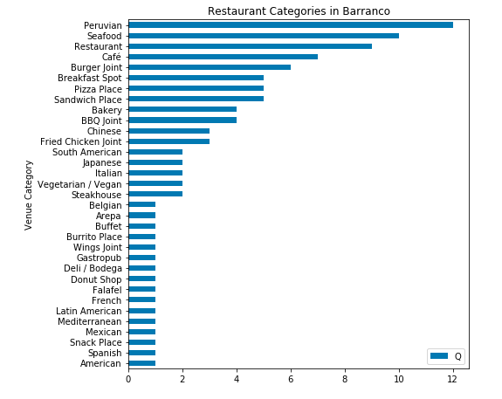
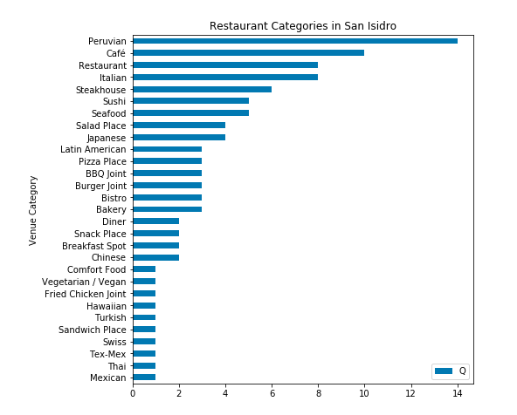
Restaurant categories

Slide 7
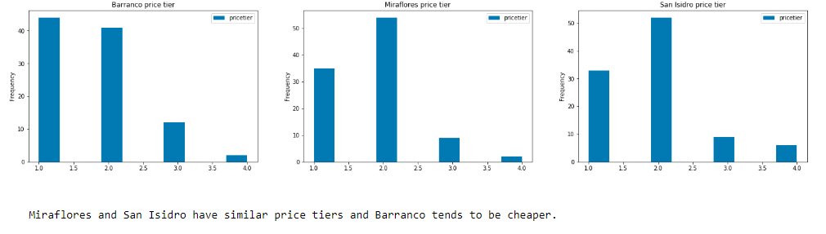
Foursquare price tiers

Slide 8
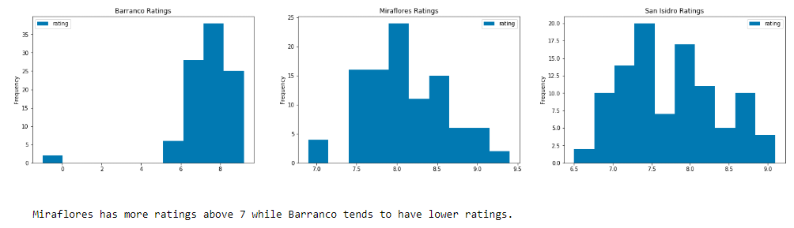
Foursquare ratings

Slide 9
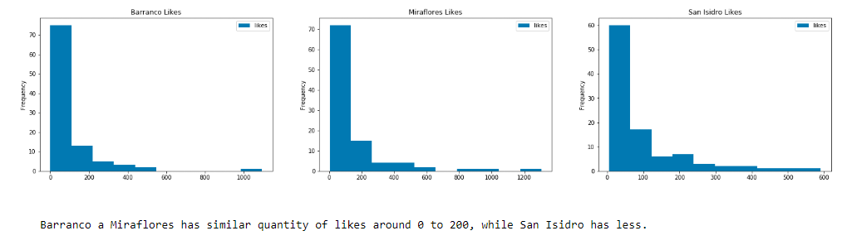
Foursquare likes

Slide 10
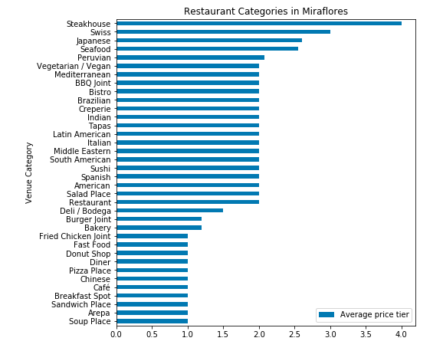
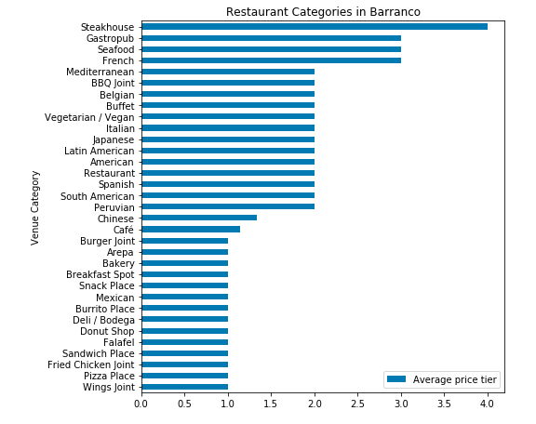
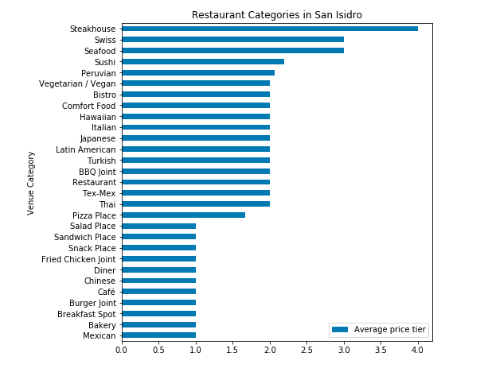
Restaurant catogories average price tier

Slide 11
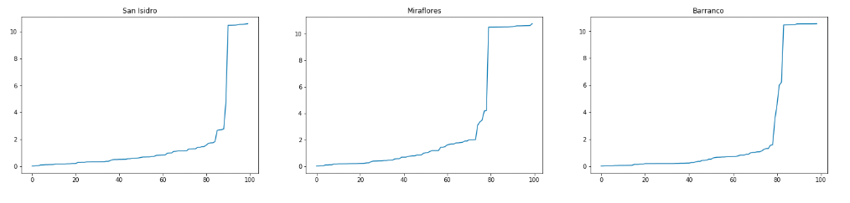
As an approach to solve the proposed problem, clustering is going to be used to identify in each district different food business opportunities. The algorithm selected is DBSCAN (an unsupervised algorithm based in density). Given our data we are going to use a min sample of 5.
And we use nearest neighbors algorithm to find the optimal epsilon. Epsilon is chosen with the point of maximum curvature[1].
After analyzing the graphs, epsilon 2, 1.8 and 2.5 were chosen for Miraflores, Barranco and San Isidro districts respectively.

Slide 12
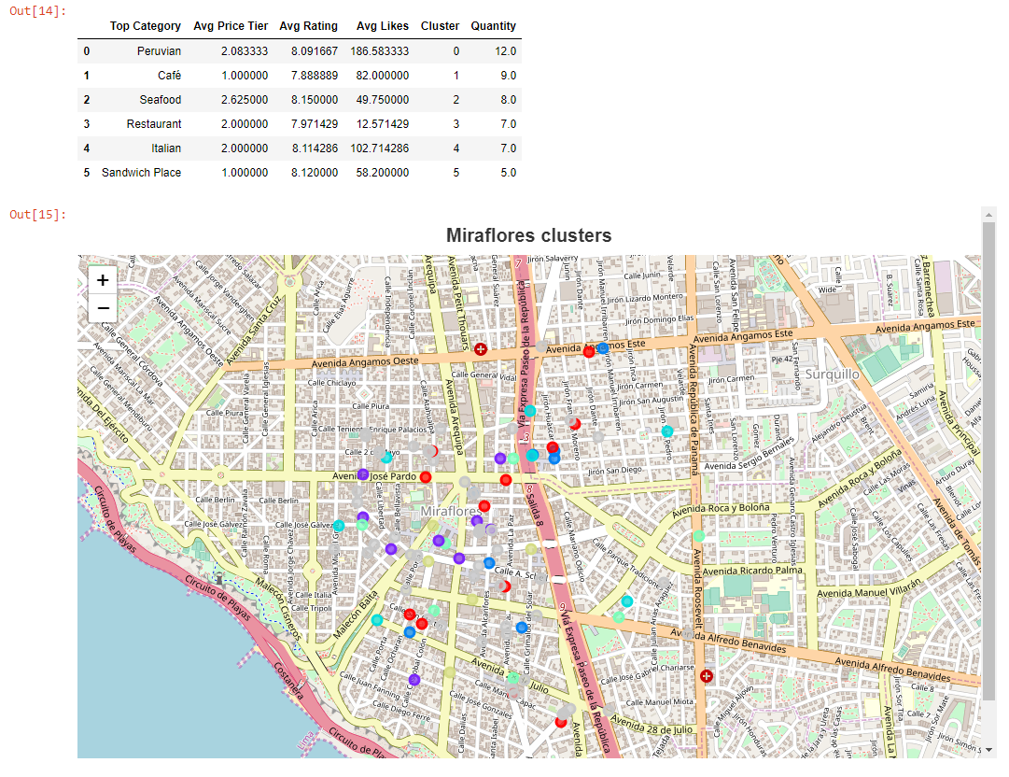
Miraflores district clusters

Slide 13
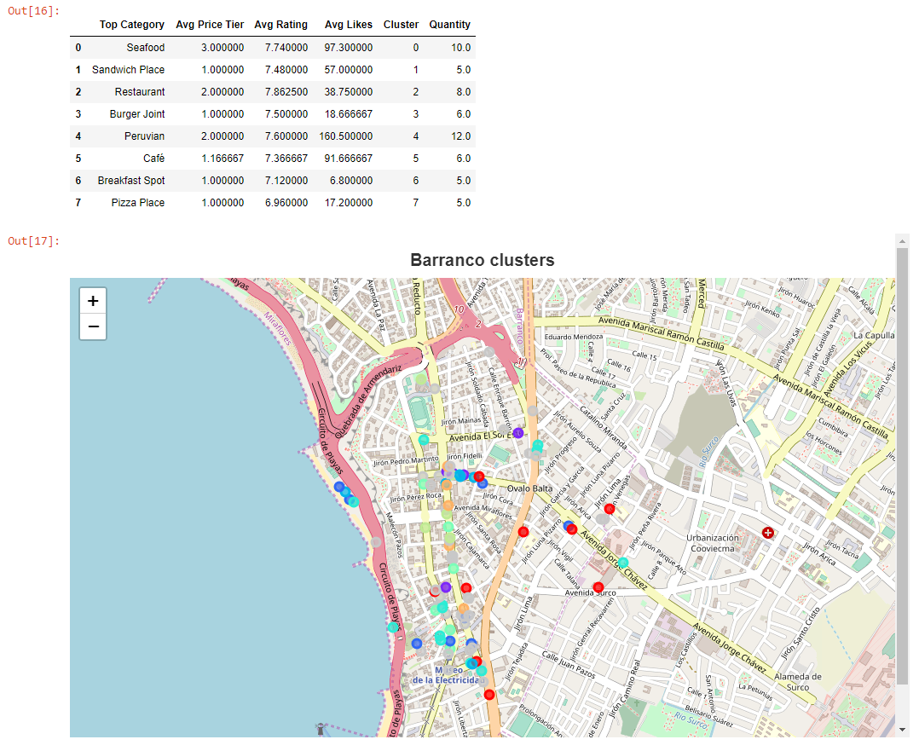
Barranco district clusters

Slide 14
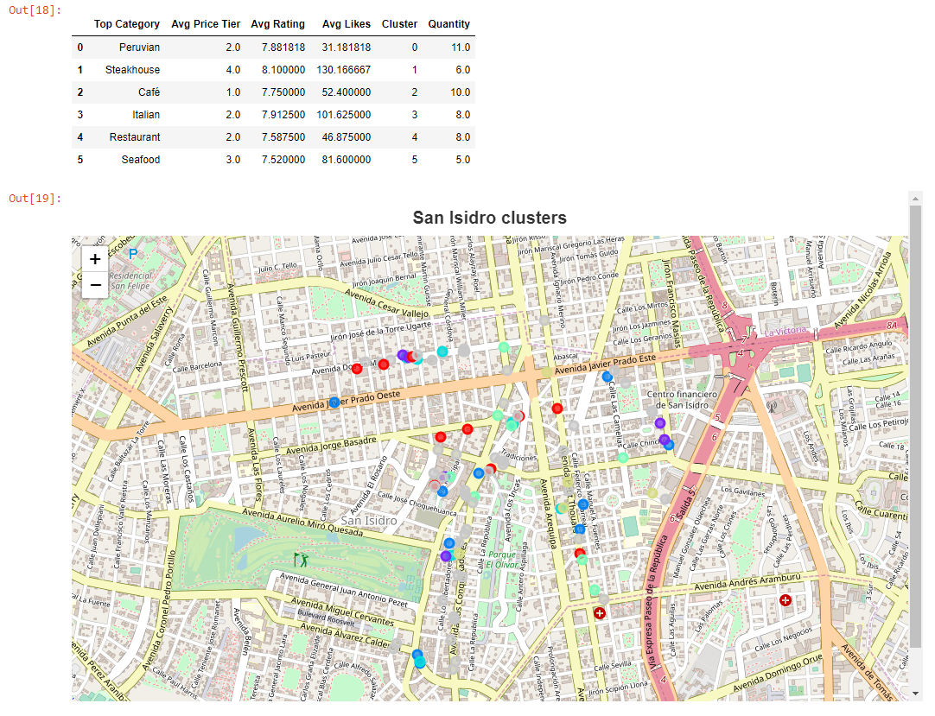
San Isidro district clusters

Slide 15
With this information the entrepreneur can select a cluster/food category according to the price he/she would like to set and can opt to establish the business near or far to similar members of the cluster in each district. Also he or she can get an idea of how popular/unpopular similar venues are in Foursquare as an indicator of future popularity.

Slide 16
This analysis can be used by entrepreneurs to choose the district in which they want to open a venue according to the category, price and popularity of their preference. Further analysis can be done with more capabilities beyond the free tier of the Foursquare API and expanding the number of venues and attributes analyzed or by choosing districts for other segments of Lima Metropolitan population.

